Slide 1



Marcel, 1 min (slide 1 to 4)
Digitalisation of feedback process on webpage / app
Presented by:
Edgard Mourão
Lavina Luke
Sabrina Cassata
Notes:
Do you still remember those two people from our previous video?

Slide 2
About helpica.ch
Helpica.ch is a start-up which aims to position itself as Switzerland’s leading cross-generational platform that brings together people who cannot perform daily tasks on their own and seek for Helpies with a kind heart that want to offer their support. This can be from simple chores like grocery shopping to more challenging tasks like assembling furniture. Helpica.ch wants to create a network of verified supporters in order to create a serving landscape where caregivers can find a trusted Helpi to support a beloved one at one finger click.
Notes:
Shorten the text, explain shortly who helpica is

Slide 3

Marcel, 1 min (slide 1 to 4)
This is Antonio and he was pretty busy when he received a call from his grandma Maria...
Notes:
This is Antonio who booked a helpie to get his grandmother Maria’s lightbulb fixed.

Slide 4

Marcel, 1 min (slide 1 to 4)
And yes... Here is his grandma
Maria, and she had some problems with a light bulb
Notes:
When the lightbulb was fixed, Antonio had some issues with the payment of the job. Therefore he wants to contact the helpica team.

Slide 5
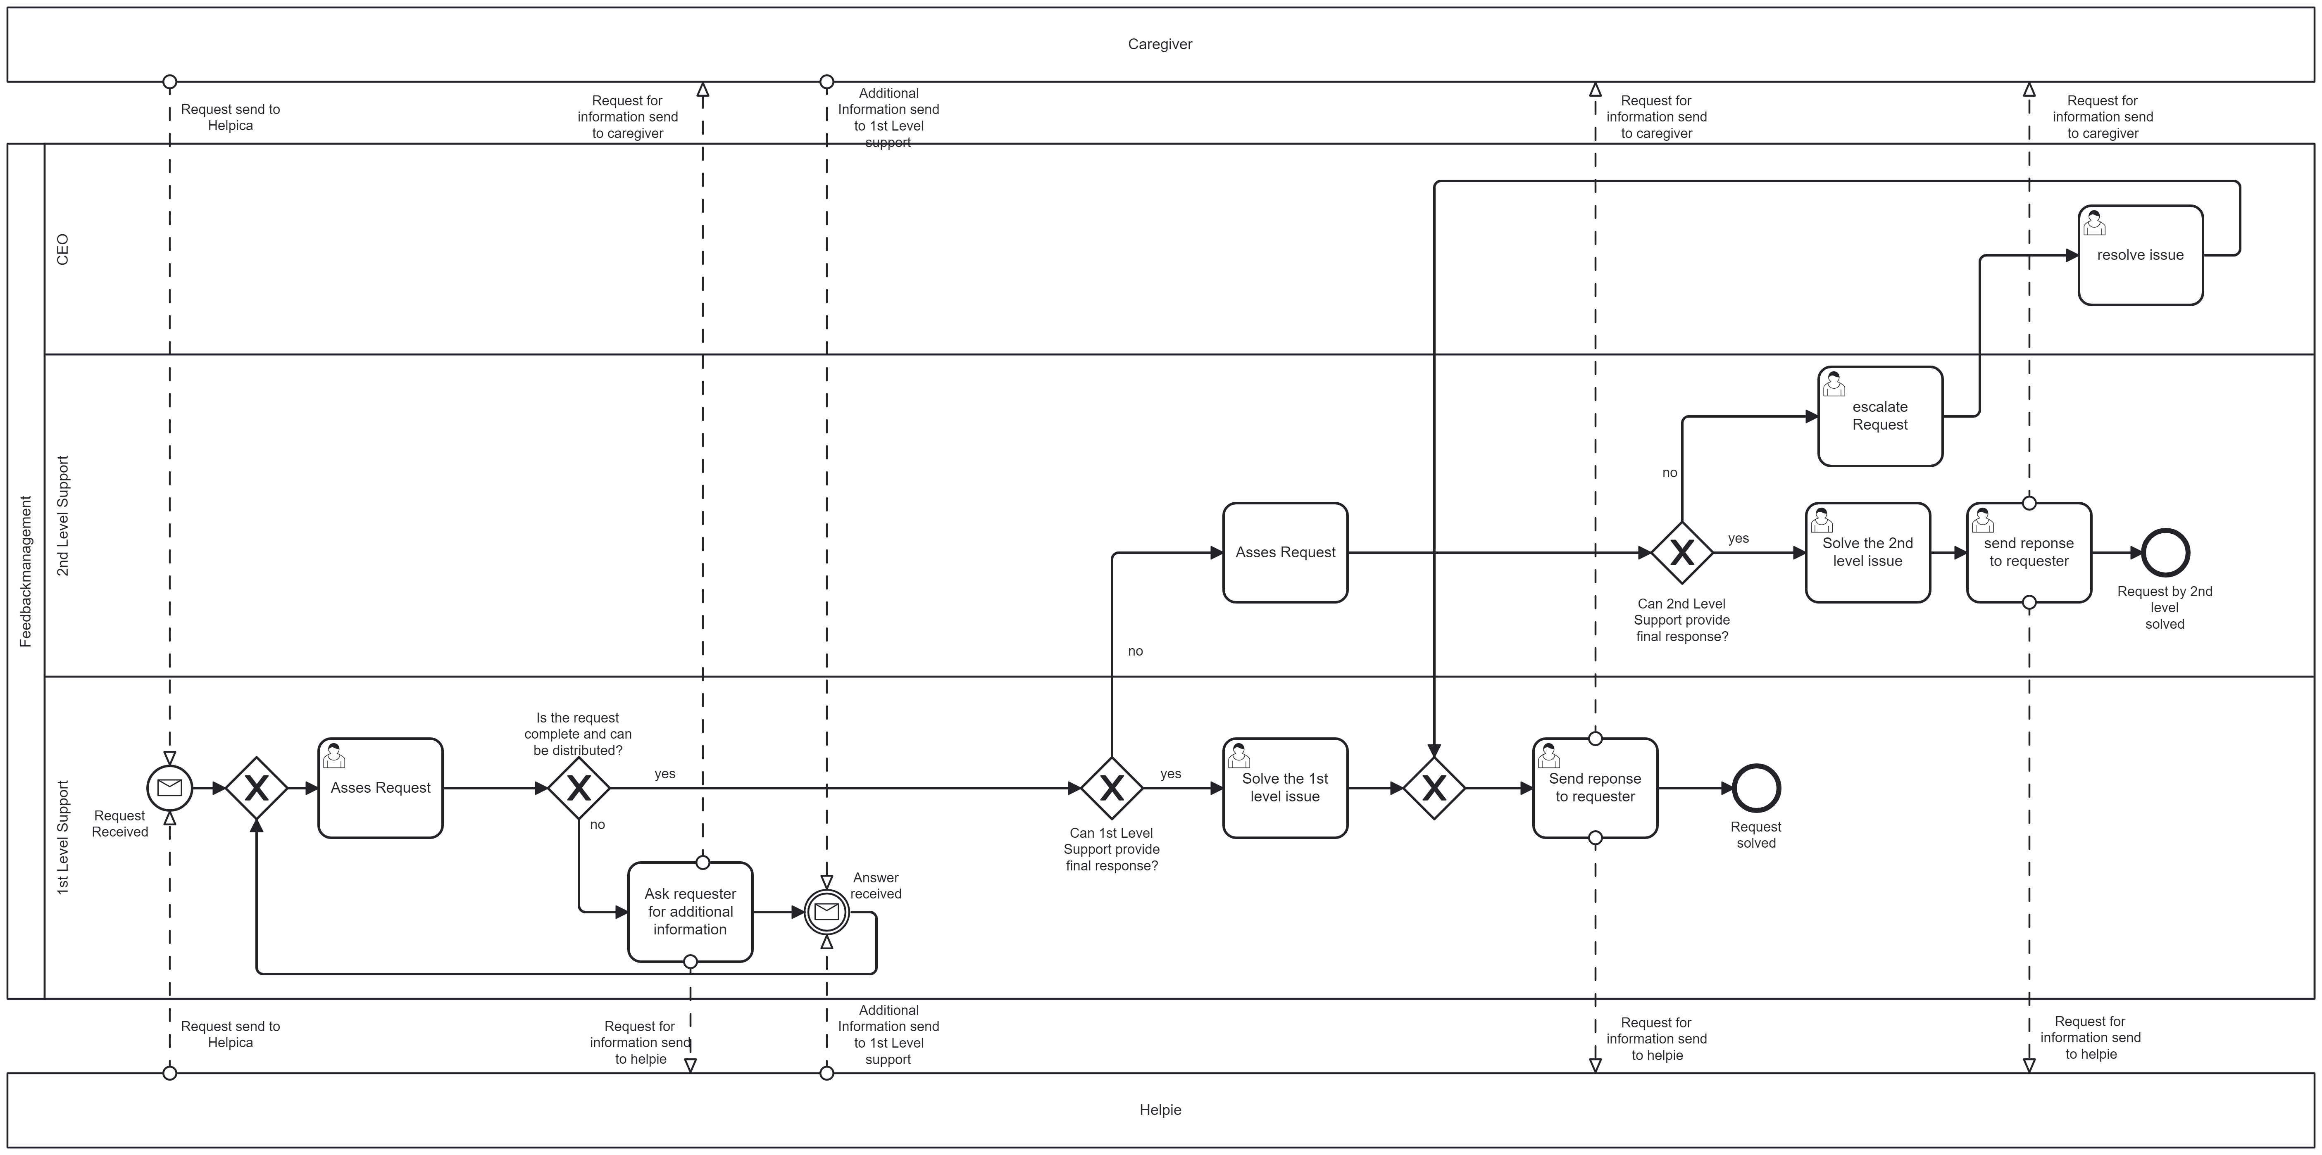
Marcel, 1 min (slide 1 to 4)
As-Is Process
Notes:
Antonio does not have any time and needs someone who fixes Marias lightbulb. And this is were Helpica, our app will help. He can enter a request and someone will fix his grandma’s problem.

Slide 6
Pain points As-Is Process
Marcel, 1.5 min (slide 5)
Time consuming
Error-prone
Cost intensive
Limited scalability
Unstructured & unsystematic recording
Tracking & monitoring difficulties
Notes:
Our mission
Connecting people who need help with people who can offer help
Establishing a community who trust each other
We have developed throughout the past 12 weeks a MVP which consists of a
Usable app, technical solution will be shown
E2E Process flow, base for further development
Survey outcome
Marketing strategy

Slide 7
To-Be Automated Process
Christian, 4 min (slide 6)

Slide 8
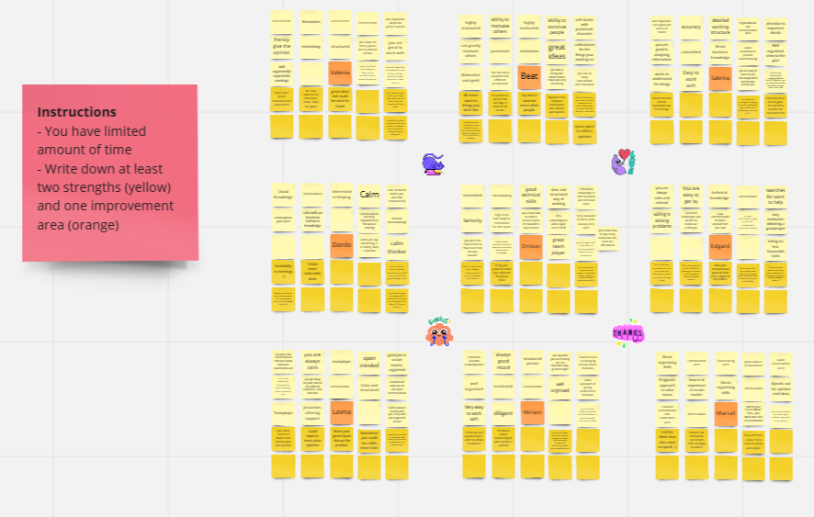
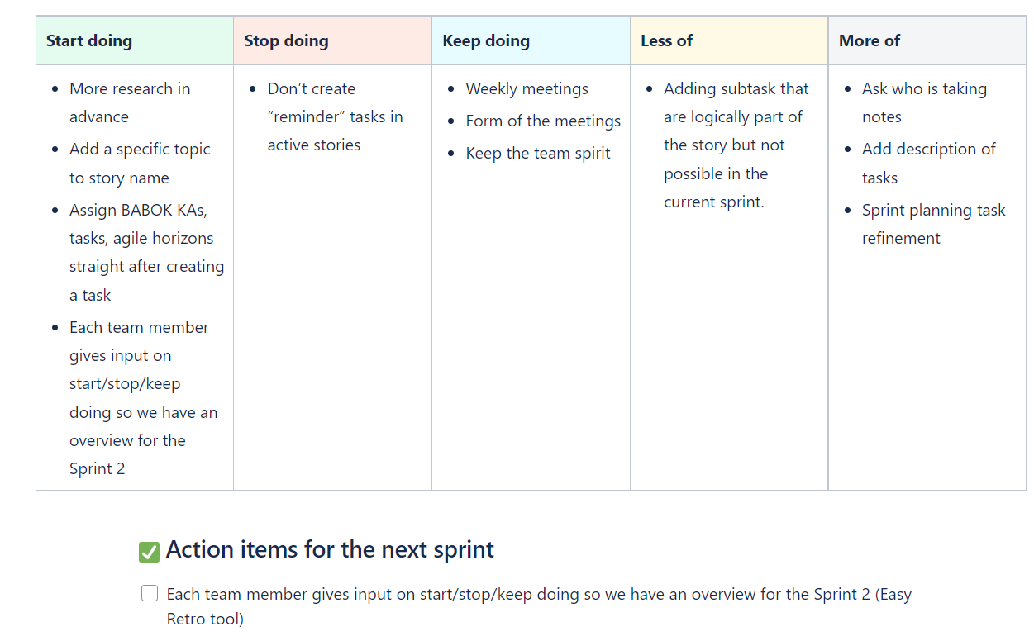
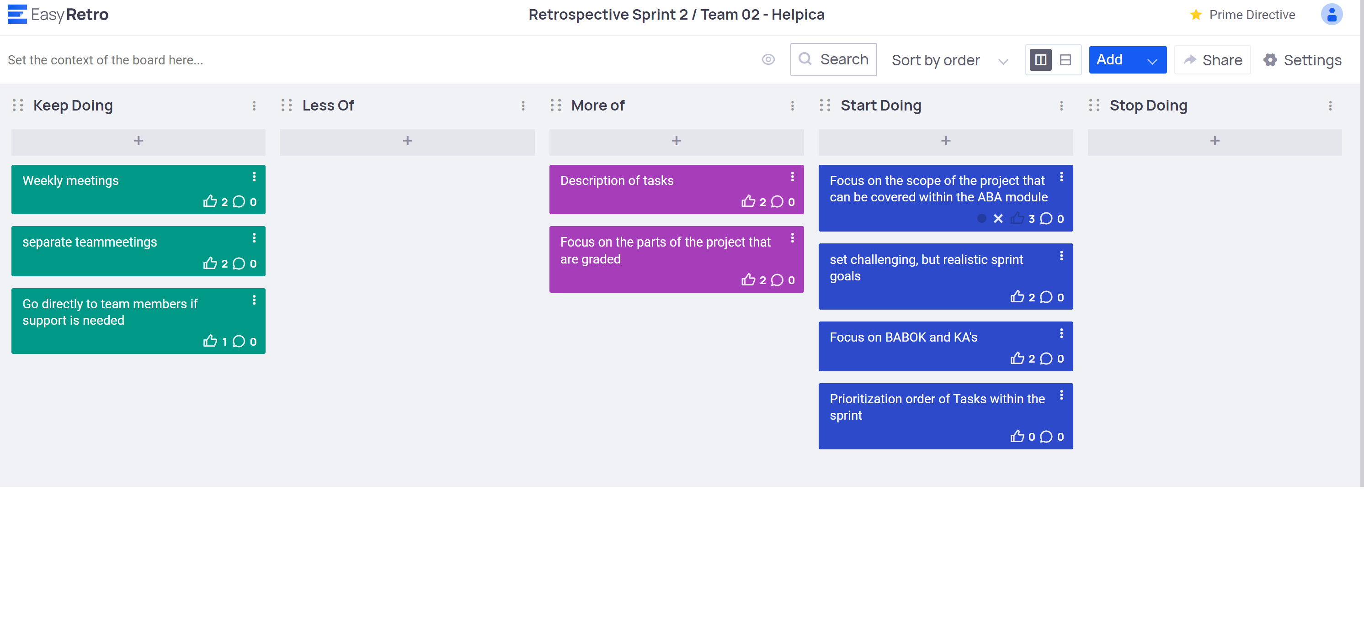
How did we get here
Miriam, 1.5 min (slide 7)
Add-on
Notes:
With this MVP we reached the goal that we set ourselves for this project. It was not an easy way and we had to try out different tools to reach it.
Working in this start-up mode with 9 people also requires that we set a focus on our teamwork. Our tool was the retro from the scrum methodology. Doing the retro forced us to reflect on our doing and how the project develops. We were all keen to improve the MVP, and therefore we did not shy back on bringing in our own ideas and critiques. However, stronger voices could influence the discussion and therefore we moved to easy-retro where we could have a less influential discussion. But similarly, to the process of creating the MVP the chosen tool might not always cover all the needs. We wanted to improve our teamwork and therefore did a personal feedback session on a Miro board where we could give feedback on each person's strengths and areas for development.
This project for sure hand an impact on us as team but should definitely also have one for the outside world. With that I hand over to Beat.
Now you have seen the technical solution but it is probably as well interesting how we have developed the solution. We have used the scrum methodology and have developed as a team.
One example which we would like to highlight is the retro:
Initially a discussion where everyone can bring in points (influenced discussion)
Adaption to individual board where each one needed to submit their POV → then discussion
However, Scrum does not cover the team building per se, therefore we have added for that part as well a point (strengths – area for developments)

Slide 9
Way forward
Beat, 2 min
(slide 8 & 9)
Impact
On product: Helping people in need by bringing our idea to life.
On us: that we can actually create something like it. Different personalities working together.
On outside world: small step but you can move something. Question if it is sustainable, currently B2B models are on the rise.
Outlook
Bringing it to life with the ImpactLab support
Content-wise:
Further develop the MVP
Identify target audience & area to start
Address the “trust” factor problem
Notes:
Coming from the how to what we expect on the way forward.
Regarding impact on the way forward I would like to highlight 3 points:
Our product: We brought an idea to life to actually help people in need. Our platform can act as a broker and we developed a first solution for it.
Us as people: We realized that we actually can create something like a platform even though it seems so far. And this with different personalities in our team
On the outside world: With our product and our learnings we can actually move something even tough in small steps. The question will be if our business model is sustainable as currently B2B models are on the rise
We have a look how our start up will further develop we can say that we want to bring it to life with the ImpactLab support. Content-wise we will focus on three points:
Further develop the technical MVP
Identify the target audience and area in which we would like to start
Solve the «trust» factor problem
To follow our further journey, have a look at our website. Thank you for listening to our summary of the past 12 months, we hope you got an interesting insights.

Slide 10

Thank you!
Beat
DigiBP, Spring Semester 2023
Team Watermelons: Edgard Mourão, Lavina Luke, Sabrina Cassata

Slide 11
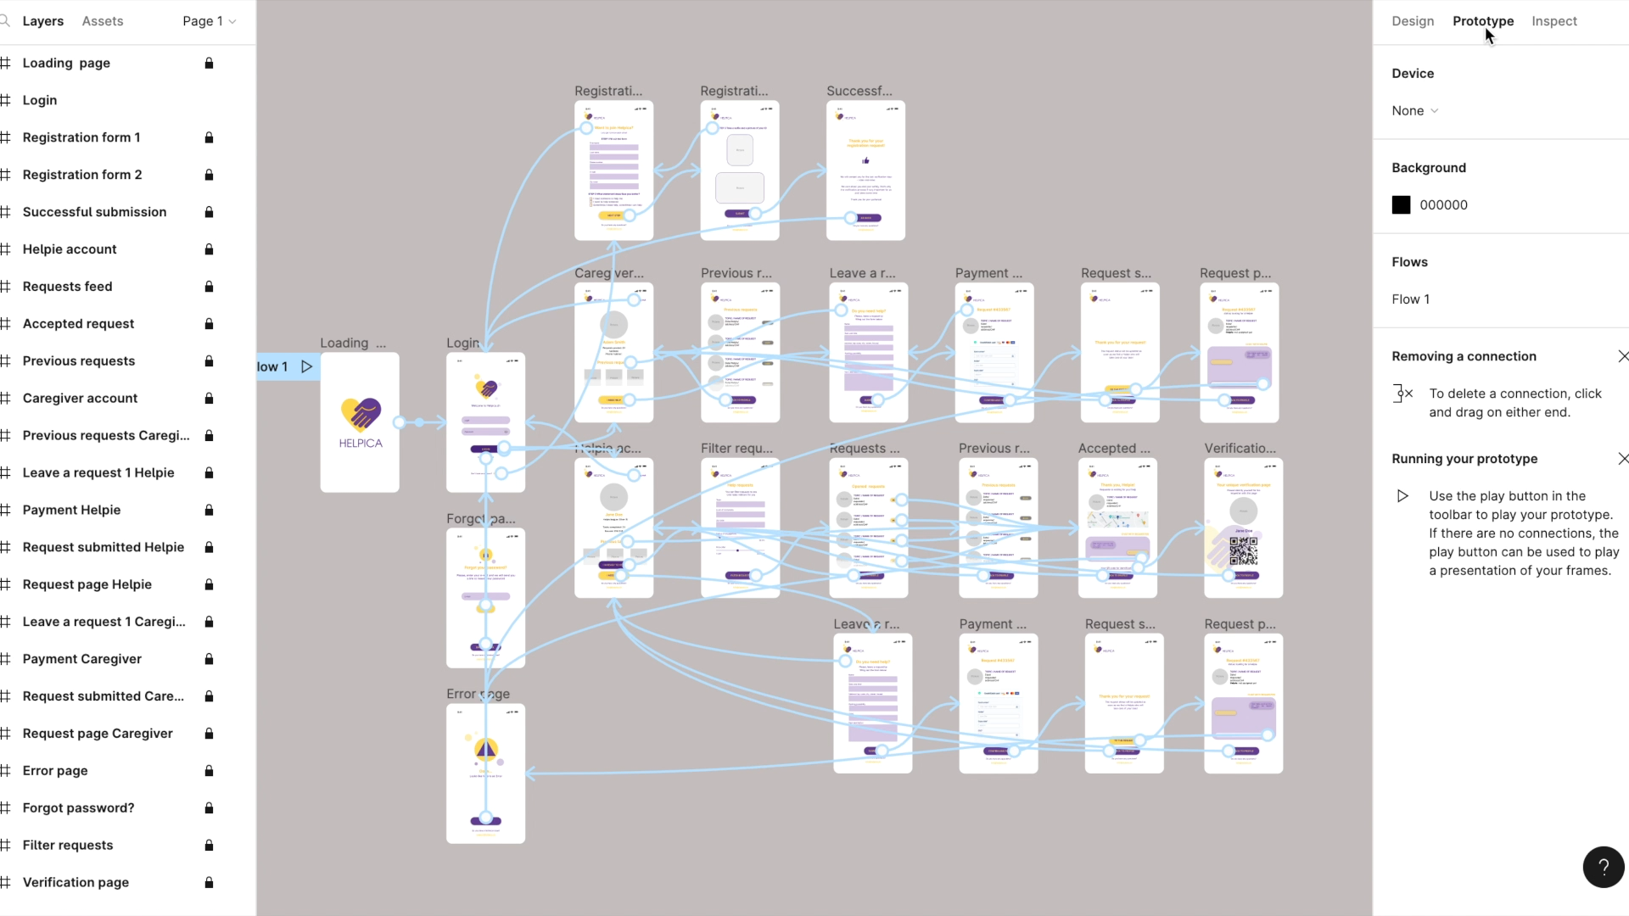

Slide 12

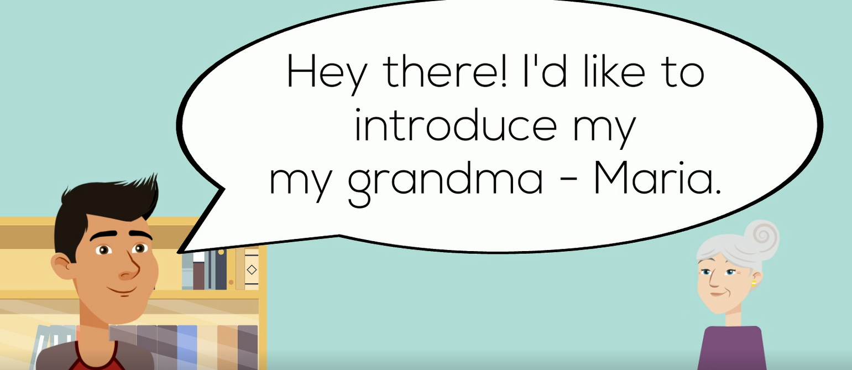
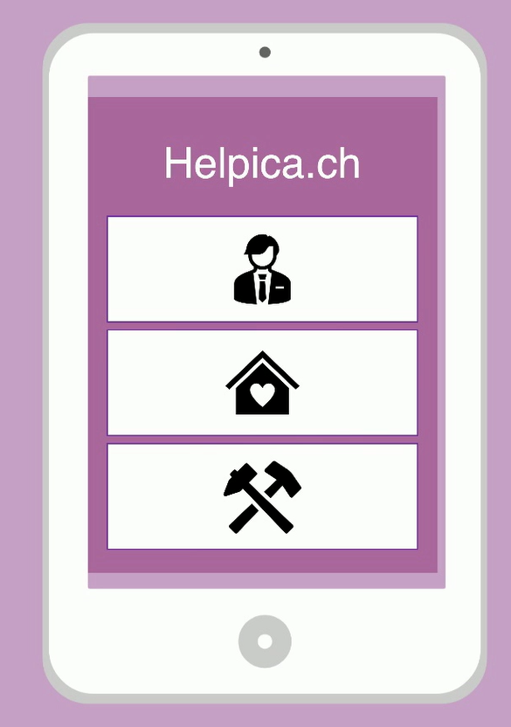

Antonio
Light bulb issue
Maria - Grandma
Notes:
Do you still remember those two people

Slide 13
What can Helpica do and how is the MVP at the moment?
Our Purpose
Y
X
X
X
X
x
Our Minimum Viable Product
X
X
Y
X
Y
Y

Slide 14
Storyline
Start with intro (animated personas from previous video), explaining how Helpica will help them
Then we are showing how Helpica has developed (what is the solution look like)
How did we manage get here and what were obstacles
What is the impact that we can have with this product incl. Outlook to the future

Slide 16
No Intro slide

Slide 17
Intro from Video
Person A (animated)
Person B (animated)
Story of Slide: Connection to video
See person A from video, then person B → do you remember them?
Answer is probably no → we have presented them in the initial pitch
Describe their problem, → and Helpica can help (coming flying in)
Moving to next slide → what Helpica can do

Slide 18
What can Helpica do and how is the MVP at the moment
Person A (animated)
Person B (animated)
To be adapted
Story of Slide: Connection to video
See person A from video, then person B → do you remember them?
Answer is probably no → we have presented them in the initial pitch
Describe their problem, → and Helpica can help (coming flying in)
Moving to next slide → what Helpica can do

Slide 19
Should we start in a very ”non-tipical way” so no one can really understand that the “oficial” presentation is starded?
E.g. Beat said while Marcel is connecting a beamer – you know, once I had 45 calls with my grandma in one day.. Know why? Because of her radio! Can you imagine? my grandma lives there and there....and once this and that happened with her radio...
Lallala and then I thought that it would be cool to have this and that solution...
Something like TED talks <- like the idea

Slide 20



THAT’S just a draft of possible structure - nothing is completed here
Different logos just in case →

Slide 21
BUSINESS – FROM IDEA TO SOLUTION main business outputs IDEA, BM VP ? Marketing? MENTION METHODS WE USED
Maja said we don’t need this stuff

Slide 22
GATHERING DATA – SURVEY, CONSLUSIONS, STAKEHOLDERS ENGAGEMENT
Maja said we don’t need this stuff

Slide 23
HOW DID WE APPLY BABOK AND HOW IT HELPED US
Maja said we don’t need this stuff

Slide 24
HOW DID WE documented the process?
Maja said we don’t need this stuff

Slide 25

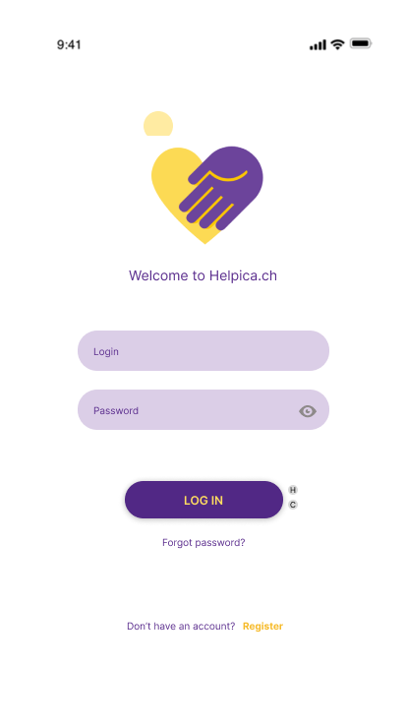
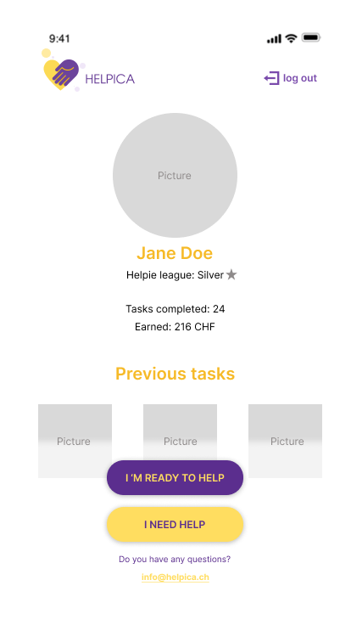
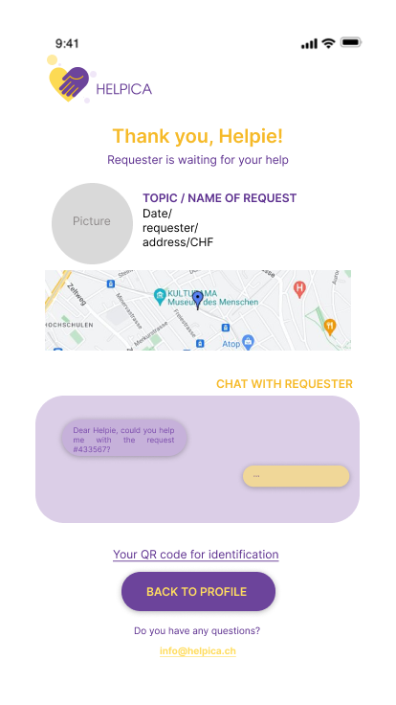
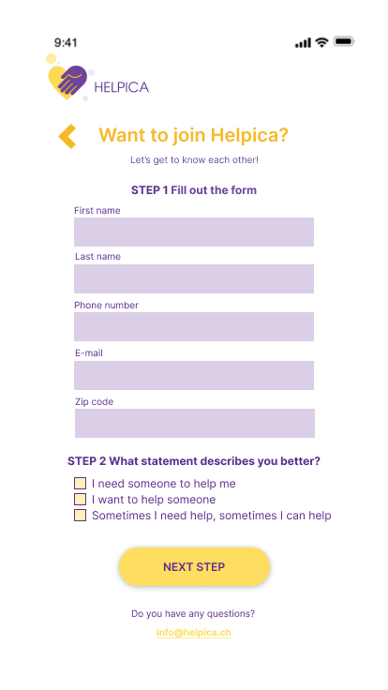
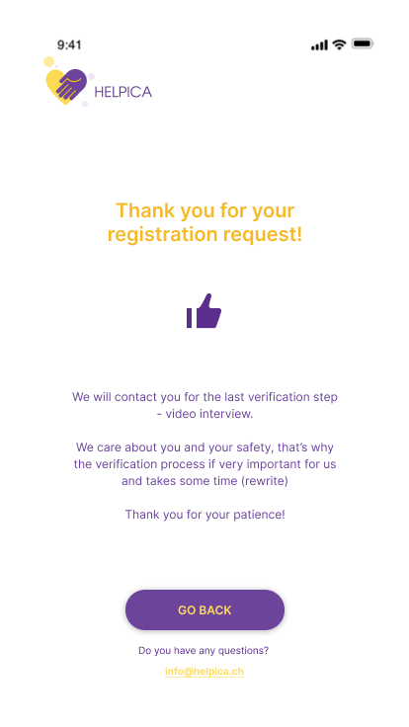
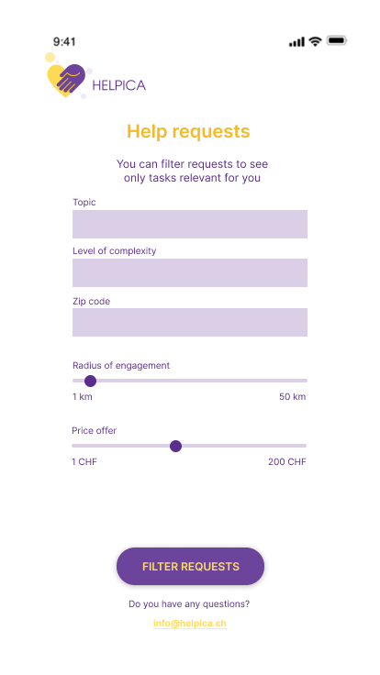
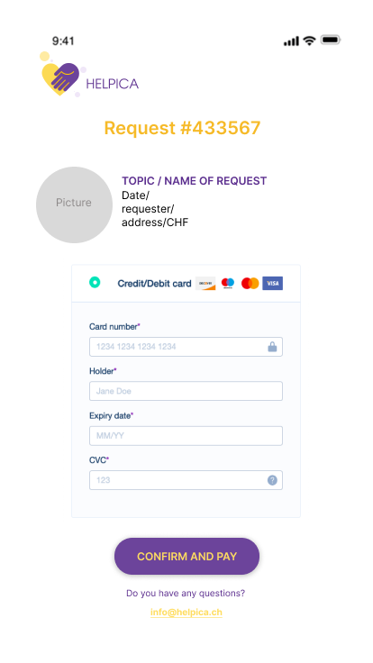
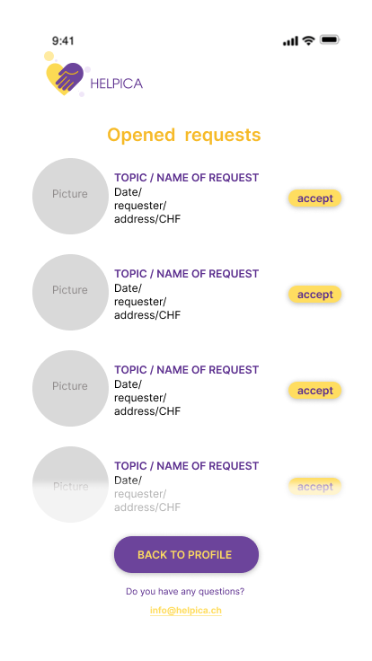
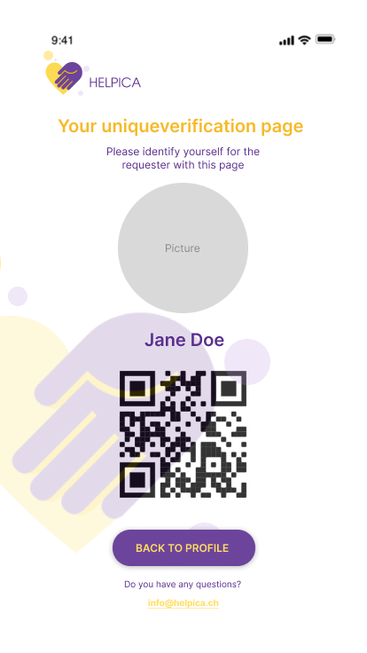
PROTOTYPE
We have a video with the prototype – can make speed x5 and let it play on the background

Slide 26
Development process – main outputs, obstacles, insights

Slide 27
MVP presentation

Slide 28
Future state, impact and conclusion – agile methodology, agile team, tools, techniques laalalal

Slide 29
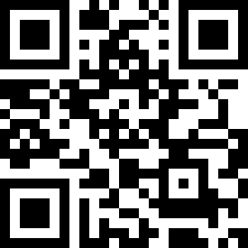
Thank you!
And… if you need help – just click

Slide 30


Helpica.ch is a Swiss cross-generational digital platform that brings together people who need help with their daily tasks and people with a kind heart who can offer them support.

Slide 31

Title
lalalalaa

Slide 32

Title
lallalalala

